Slide 1


Slide 2
What’s in it for you ?
What is Ansible ?
Why Ansible ?
Pull Vs Push Configuration tool
Common Ansible use cases
Ansible Architecture

Slide 3

What is Ansible ?
Ansible was originally written by Michael DeHaan.
Ansible is an open source configuration management and orchestration utility.
Using this you can automate and standardize the configuration of remote hosts and virtual machines.
Ansible, Inc. was the company setup to commercially support and sponsor Ansible. Later it was acquired by RedHat in October 2015.

Slide 4
Ansible is the tool that provides
IT Automation :
Instructions are written to automate the IT professional’s work.
Instructions can be executed in multiple remote hosts.
Configuration Management :
Consistency of all systems in Infrastructure is maintained.
Mainly used for patch management.
Automatic Deployments :
Applications are deployed automatically on variety of environments.

Slide 5
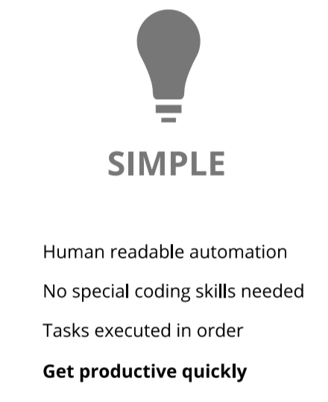
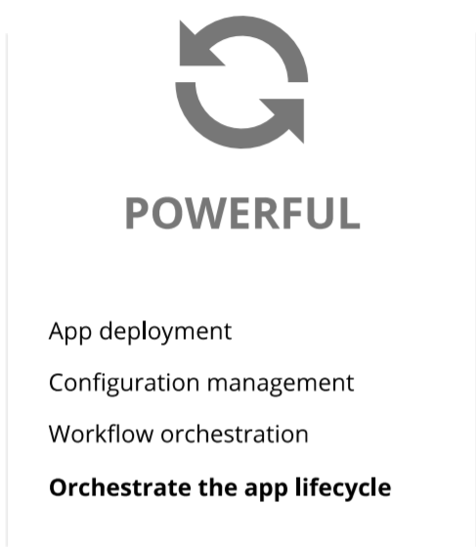
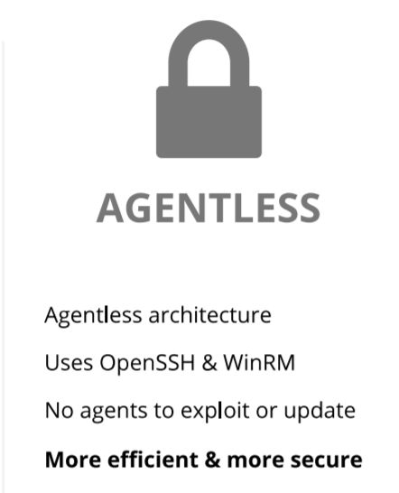
Why Ansible ? ITs SIMPLE POWERFUL AGENTLESS

Slide 6
Scenario to make bit more understand
SAM is an system admin.
That’s easy !! Wouldn’t take much time either.
But what if the number of Servers increased?
He must install Apache on 3 web servers & MySQL on two DB servers
Web Servers
The same task must be repeated multiple times.
He is responsible for his company Infra
Problem here is humans are prone to make errors.
DB servers
This is where ansible comes to rescue.
Now SAM can work on more productive tasks rather then repetitive once
With ansible code written once for installation & it can be deployed multiple times

Slide 7
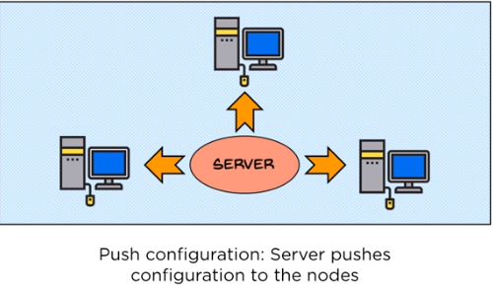
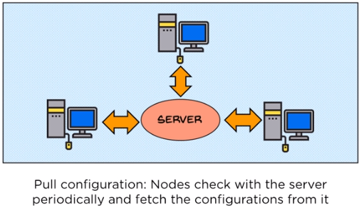
Pull Vs Push Configuration tool
Pull Configuration Tools
Push Configuration tool
In Pull based Tools, there will be an MASTER server where all the instructions are placed and then it also has the information’s of client machines connected to it.
Then piece of software which also called as agent installed on all other SLAVE machines which will enable the communication between MASTER and SLAVE.
This also has MASTER server which passes set of instructions to clients but major difference here is its doesn’t need any agent to be installed on SLAVES.
Here you are just achieving your job by simply pushing the changes to SLAVE machine and forcing it to restructure.

Slide 8


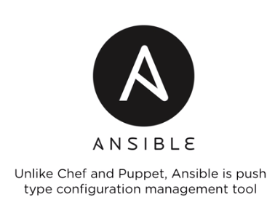
Cont…
Pull Configuration Tools
Push Configuration tool
Any idea on what would be pull configuration tools ?
Disadvantage :
Whenever new machine comes into Environment you need install the agent on it to establish communication between master and slave.
When Master is upgraded with newer version all Client agents should be upgraded.
Any idea on what would be push configuration tools ?

Slide 9
Common Ansible use cases
Provisioning
Configuration Management
App Deployment
Continuous Delivery
Security & Compliance
Orchestration

Slide 10
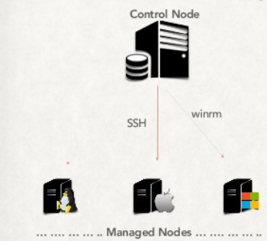
Ansible Architecture
Prerequisites to have Ansible in your Environment.
One control node to be installed with Ansible in any Linux flavor.
Managed Nodes can be with any OS, it can be LINUX, APPLE and WINDOWS.
Linux nodes and Mac nodes will be managed through SSH agent.
WINDOWS nodes will be managed to WINRM agent.

Slide 11
End…

